Slide 1

AML-2304 Natural Language Processing
Lambton College
School of Computer Studies
[Prepared By: Vahid Hadavi, PhD]

Slide 2
Lecture4 4. Demonstrate Text Preprocessing: Replacing and Correcting Words
Major Topics:
4.1 Illustrate Text conversion to Lowercase
4.2 Apply Number Removal, Punctuation Removal, and Whitespace Removal
4.3 Use Parts of Speech Tagging (POS)
4.4 Practice Named Entity Recognition
4.5 Show Collocation Extraction and Synonyms
4.6 Demonstrate use of Word Lengthening to detect sentiment
4.7 Apply Spell Correction

Slide 3
4.1 Illustrate Text conversion to Lowercase

Slide 4
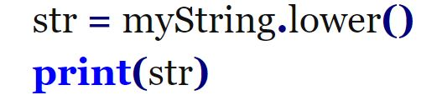
Text conversion to Lowercase
It may be necessary for to convert a text into lowercase.
We can use lower() function provided by Python on our text to convert it into lowercase.
Challenge question : Create tokens from the above string using nltk and convert to upper case

Slide 5
4.2 Apply Number Removal, Punctuation Removal, and Whitespace Removal

Slide 6
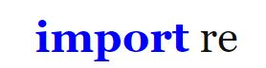
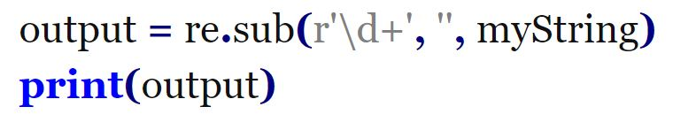
Number removal
You may not want to work with numbers in your analysis.
Number removal can be done in Python using regular expressions.

Slide 7
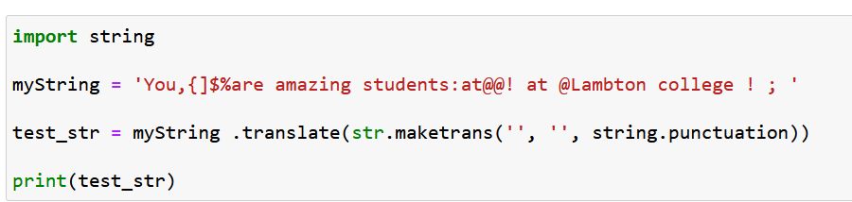
Punctuation removal
We may want to remove punctuations from our text for easy processing.
Examples of such symbols include #, $, %, *, & (), +, -, ., /, :, ;, <=>, ?, @, [, \, ], ^, _, `, {, |, }, ~, ].

Slide 8
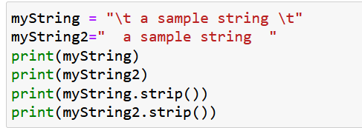
White space removal
We may want to work with text without leading and ending spaces.
You can do away with these from your text by calling the strip() method.

Slide 9
4.3 Use Parts of Speech Tagging (POS)

Slide 10
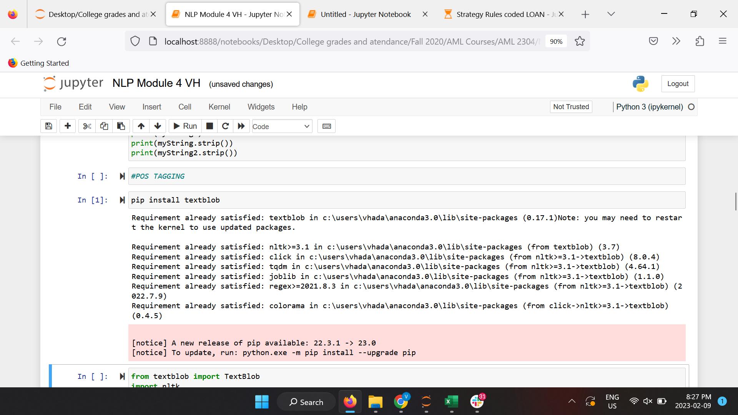
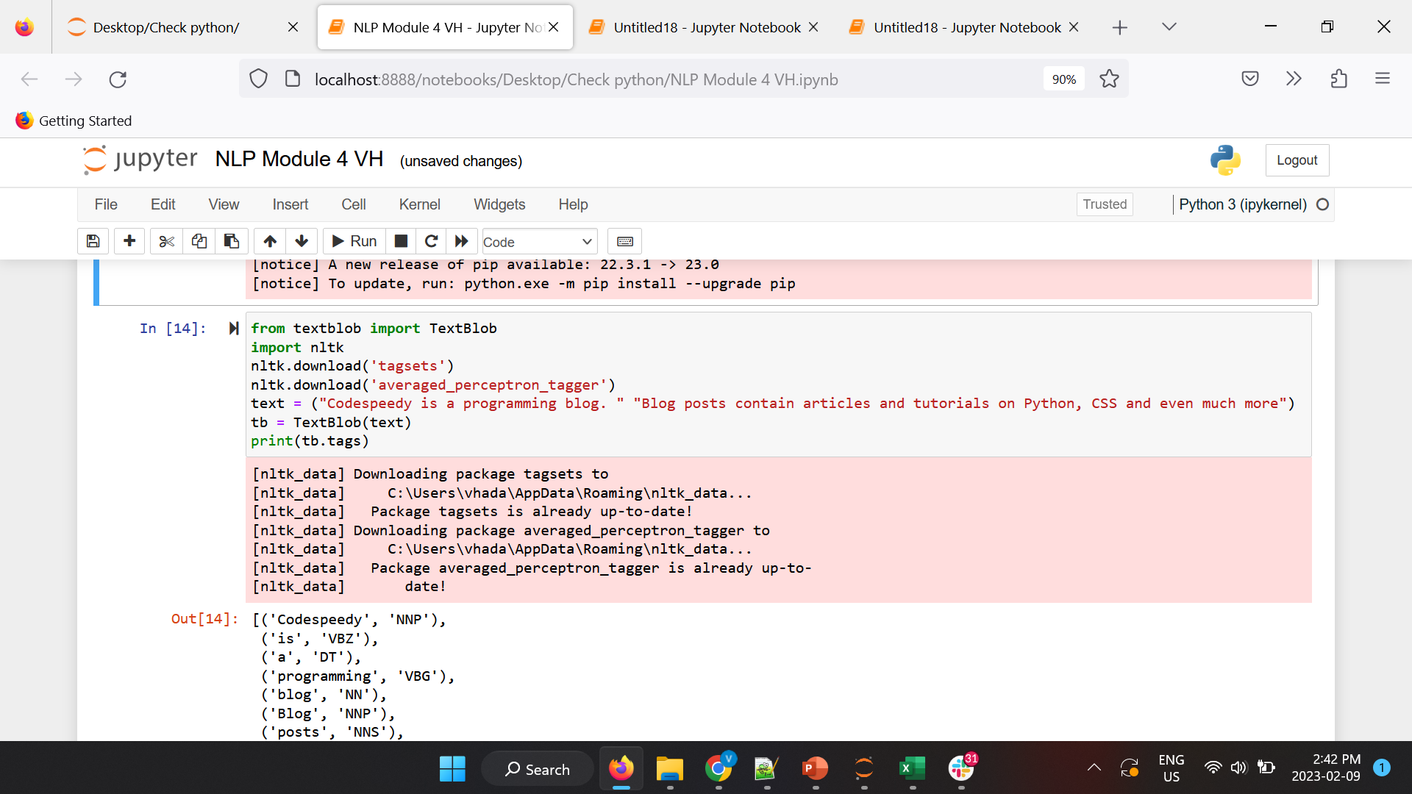
POS
The goal of POS is to assign the various parts of a speech to every word of the provided text.
This is normally done based on the definition and the context.
There are various tools that provide us with POS taggers, including NLTK, TextBlob, etc.
In this lecture, we will use TextBlob.
It needs to be installed (pip for windows).

Slide 11
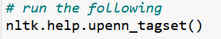
POS
How can we figure out the description if each POS tag?

Slide 12
4.4 Practice Named Entity Recognition

Slide 13
Named Entity Recognition
Named Entity Recognition (NER) seeks to locate and classify named entities in text into pre-defined categories such as the names of persons, organizations, locations, expressions of times, quantities, monetary values, percentages, etc.
NER is used in many fields in Natural Language Processing (NLP), and it can help answering many real-world questions:
Which companies were mentioned in the news article?
Were specified products mentioned in complaints or reviews?
Does the tweet contain the name of a person? Does the tweet contain this person’s location?

Slide 14
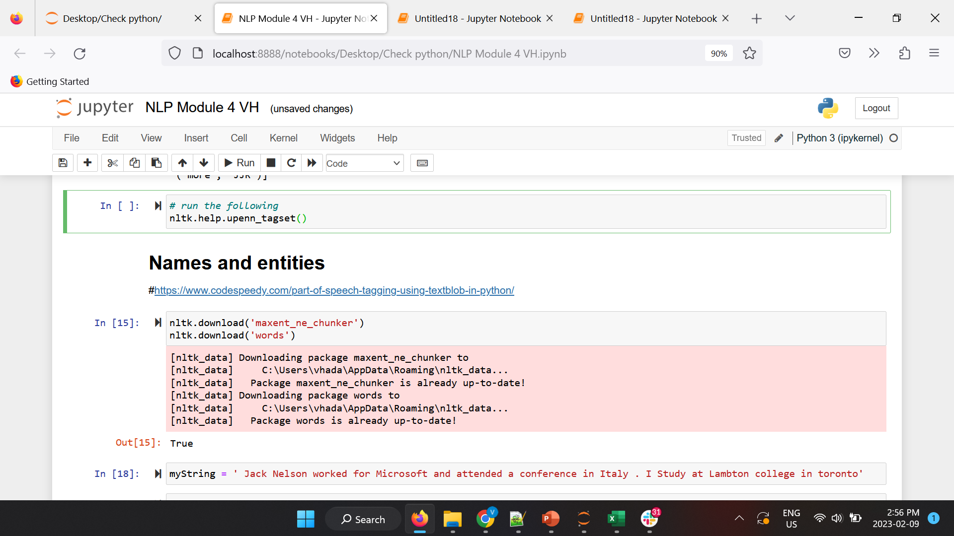
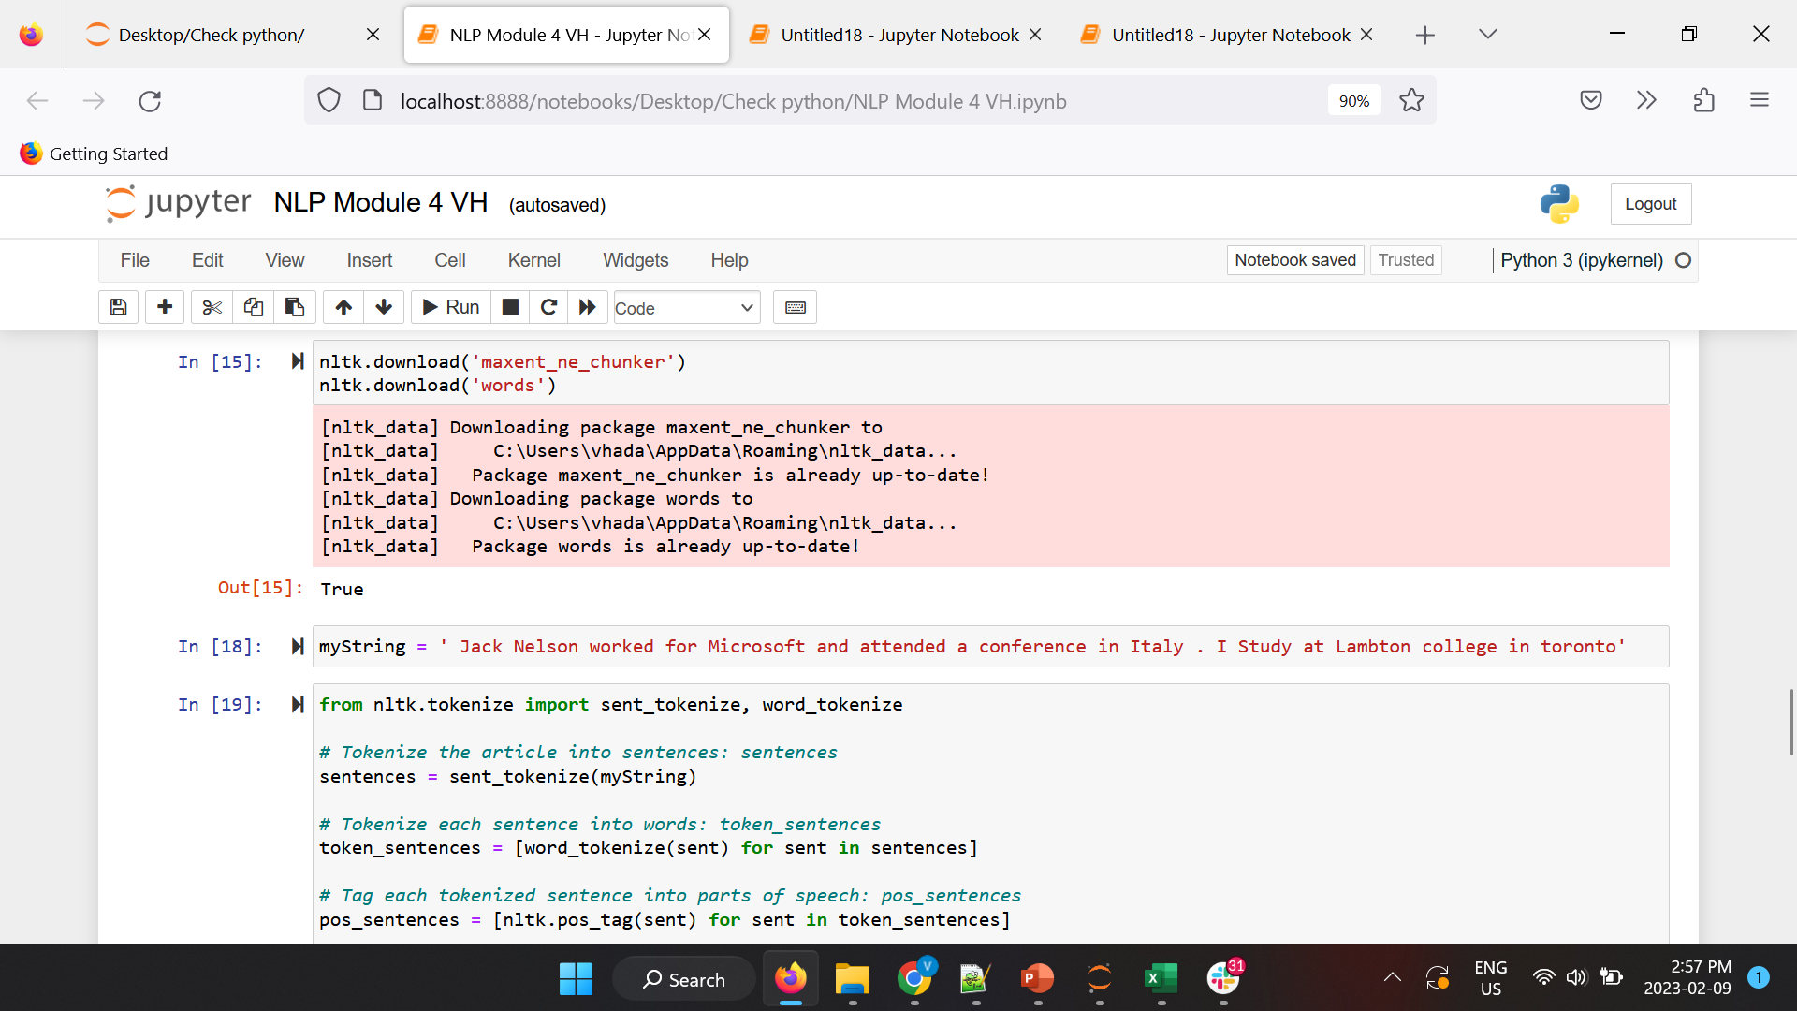
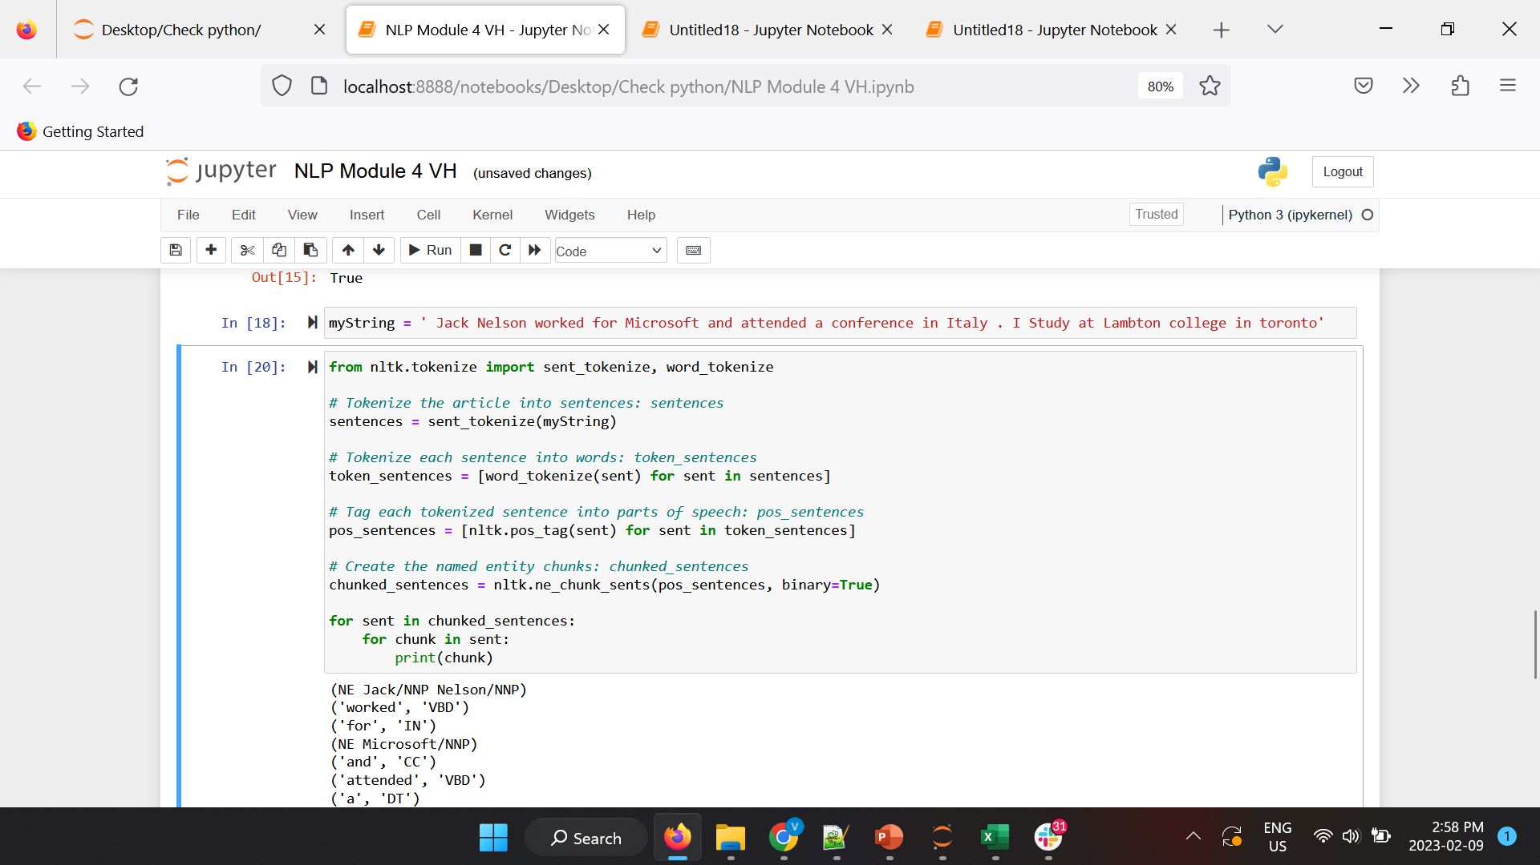
Named Entity Recognition

Slide 15
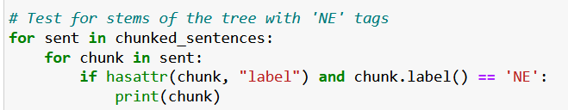
Named Entity Recognition
Challenge Question : Only print out name entities ?

Slide 16
4.5 Show Collocation Extraction and Synonyms

Slide 17
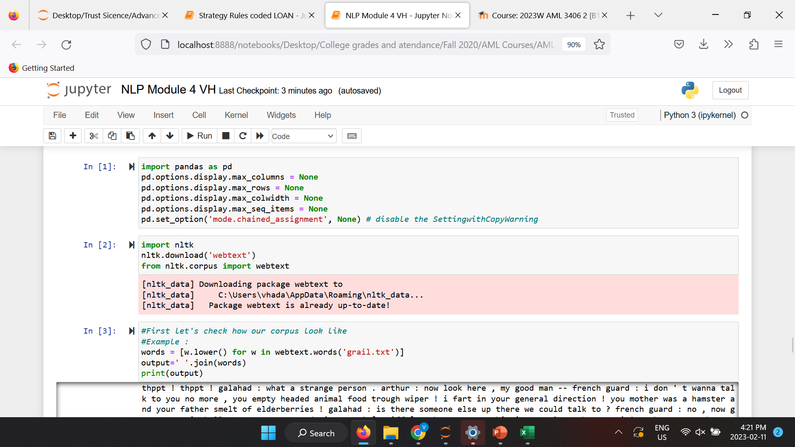
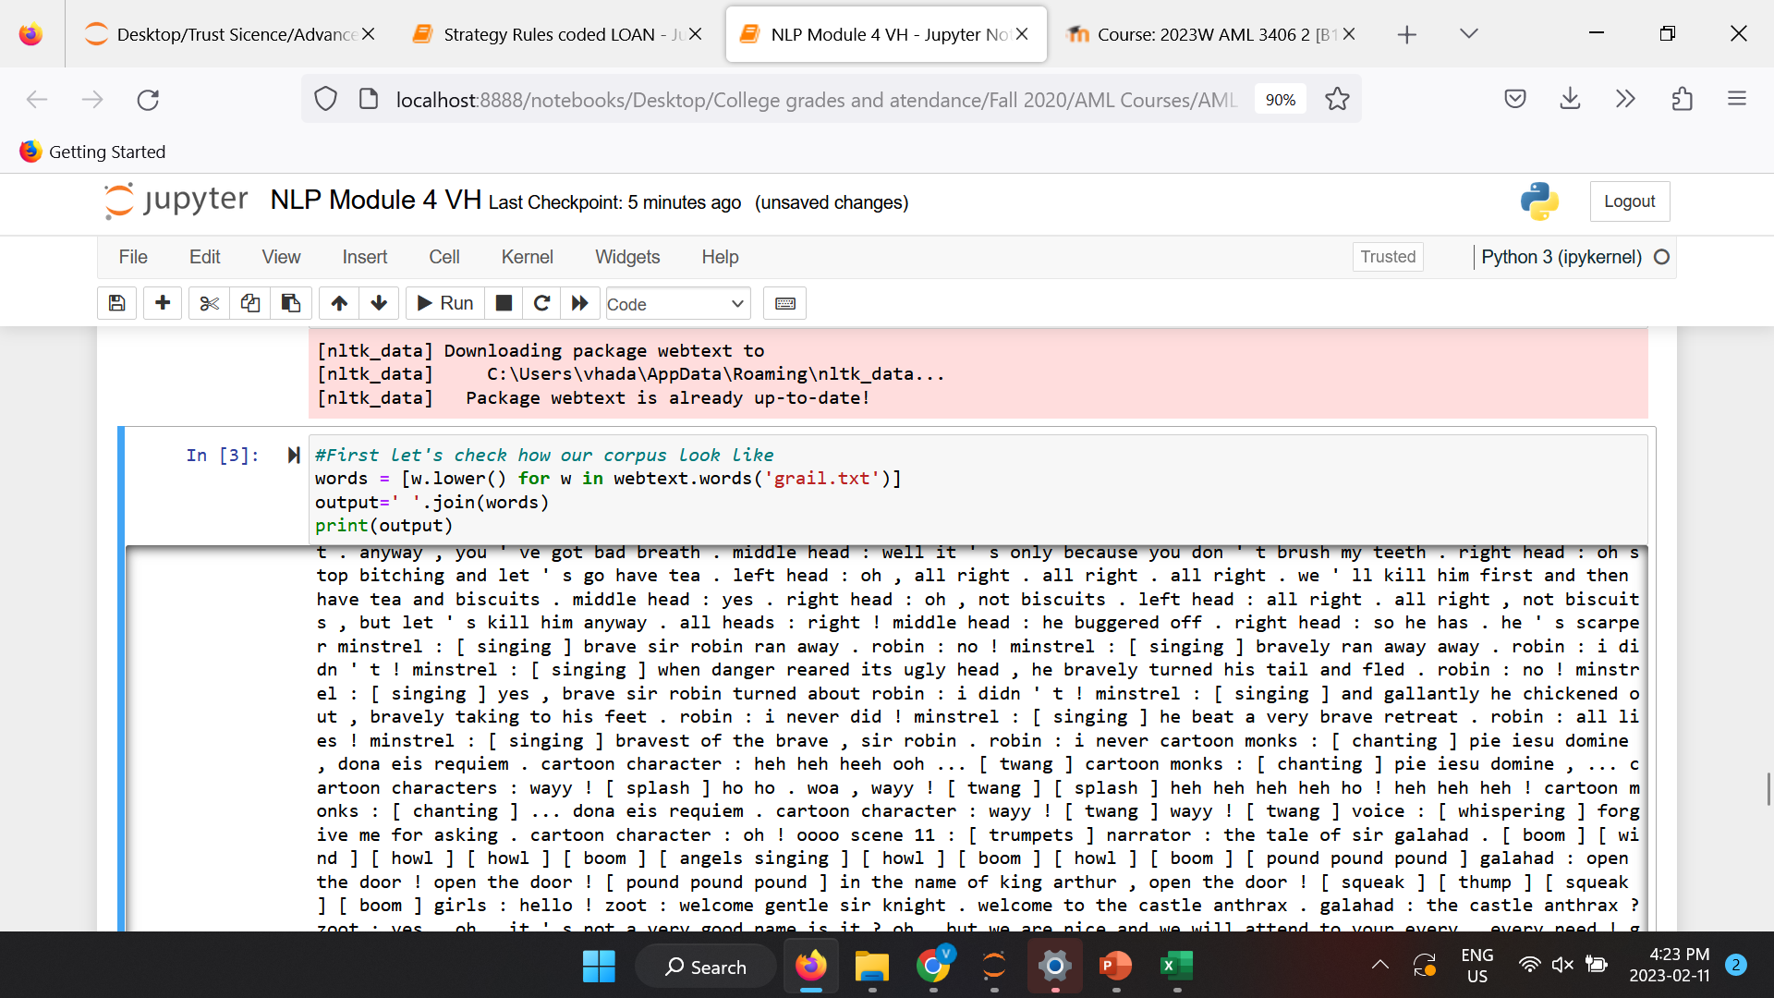
Discovering Word Collocations
Collocations are two or more words that tend to appear frequently together, such as United States. Of course, there are many other words that can come after United, such as United Kingdom and United Airlines. As with many aspects of natural language processing, context is very important. And for collocations, context is everything!
In the case of collocations, the context will be a document in the form of a list of words. Discovering collocations in this list of words means that we'll find common phrases that occur frequently throughout the text. For fun, we'll start with the script for Monty Python and the Holy Grail.
Getting ready
The script for Monty Python and the Holy Grail is found in the webtext corpus, so be sure that it's unzipped at nltk_data/corpora/webtext/.

Slide 18
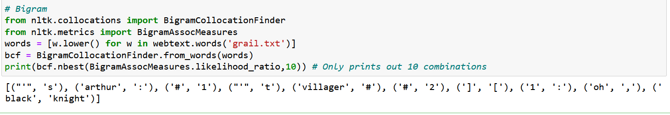
Collocation (How to do it...)
We're going to create a list of all lowercased words in the text, and then produce BigramCollocationFinder, which we can use to find bigrams, which are pairs of words. These bigrams are found using association measurement functions in the nltk.met rics package, as follows:
Challenge question : The above output is not what we expected…. discuss possible reasons with your classmates!

Slide 19
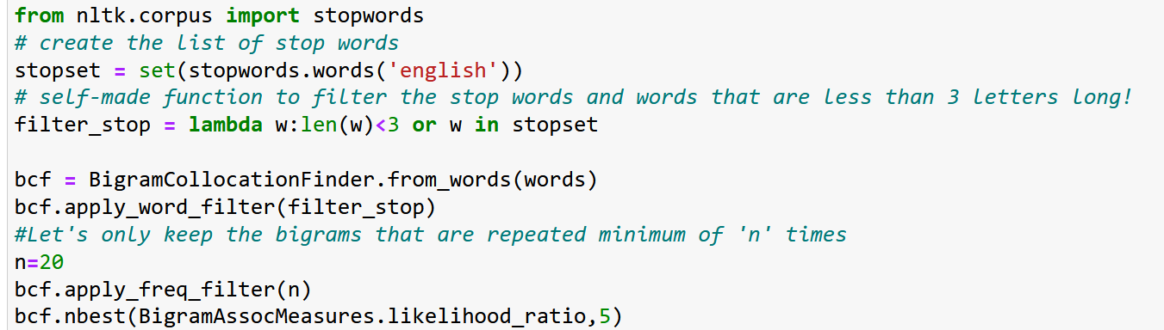
Collocation (Let’s improve the Bigrams)
Well… the earlier outcome was not very useful! Let's refine it a bit by adding a word filter to remove punctuation and stopwords:
Much better, we can clearly see the most common bigrams in Monty Python and the Holy Grail.
Try the above code with out specifying a minimum frequency for each Bigram and compare the results!

Slide 20
Collocation (Bigrams … How it works...)
BigramCollocationFinder constructs two frequency distributions: one for each word, and another for bigrams.
A frequency distribution, or FreqDist in NLTK, is basically an enhanced Python dictionary where the keys are what's being counted, and the values are the counts.
Any filtering functions that are applied reduce the size of these two FreqDists by eliminating any words that don't pass the filter.
By using a filtering function to eliminate all words that are one or two characters, and all English stopwords, we can get a much cleaner result.
After filtering, the collocation finder is ready to accept a generic scoring function for finding collocations.

Slide 21
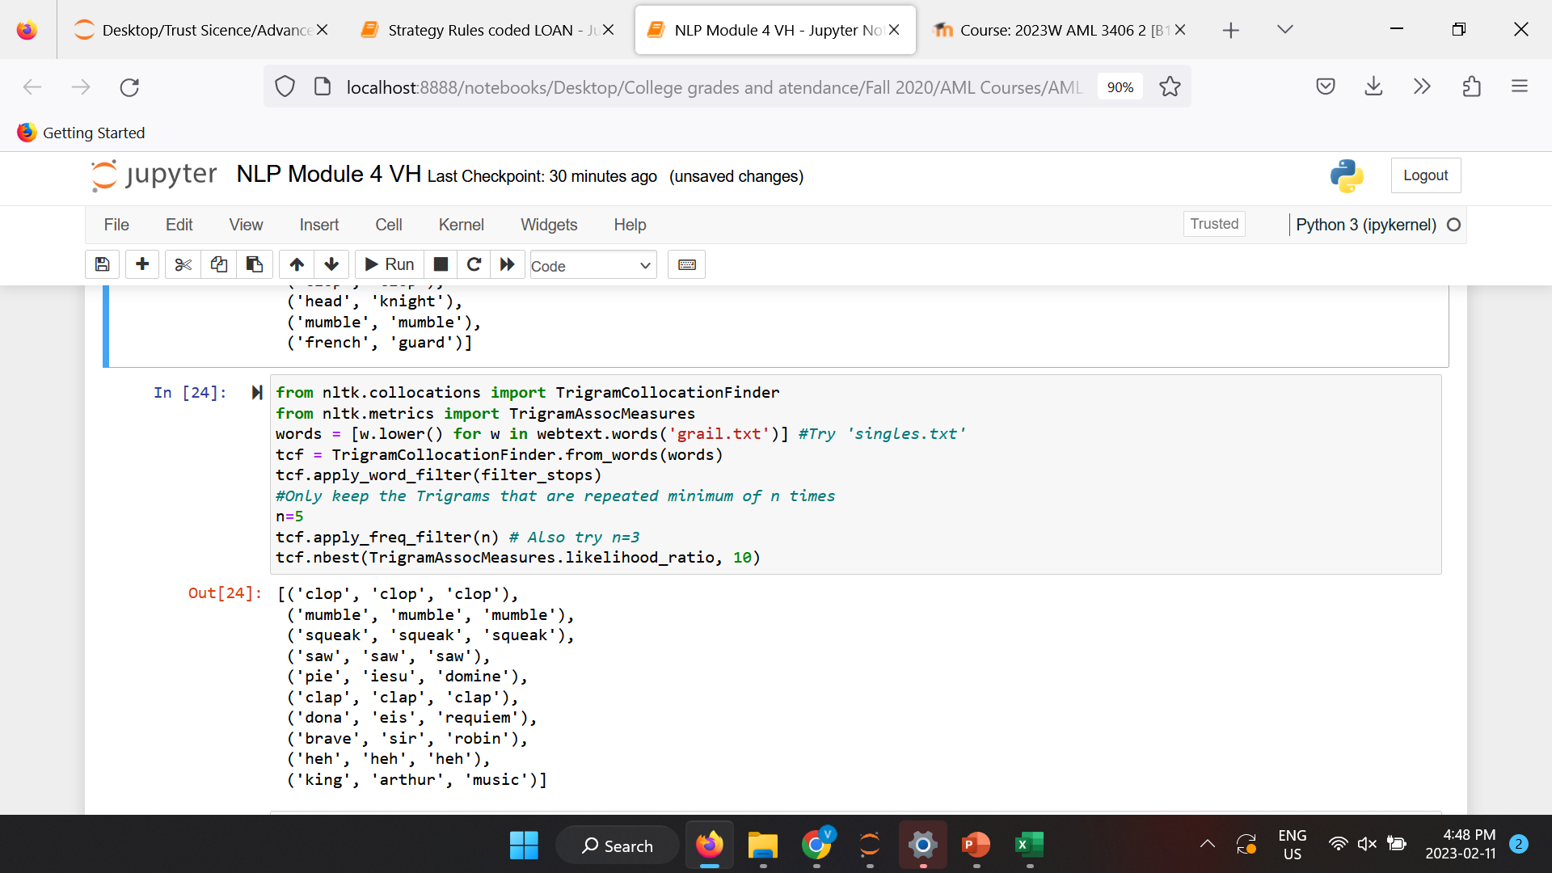
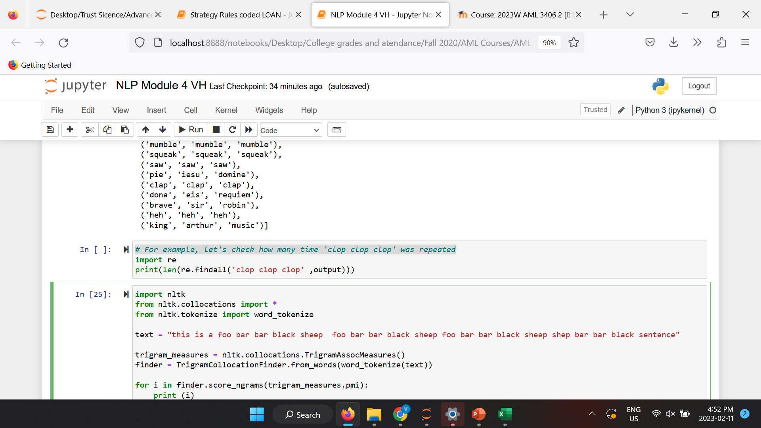
Collocation (Trigram)
There's also TrigramCollocationFinder, which finds triplets instead of pairs.
For example, let's check how many time 'clop clop clop' was repeated

Slide 22
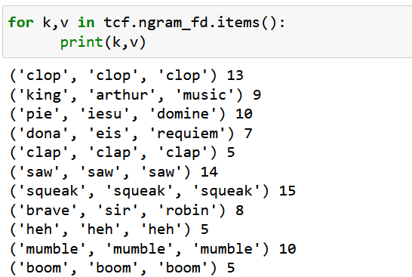
Collocation (Trigram)
Count the frequency of each Trigram:

Slide 23
Collocation (Pointwise mutual information or PMI)
In statistics, probability theory and information theory, pointwise mutual information (PMI), or point mutual information, is a measure of association. It compares the probability of two events occurring together to what this probability would be if the events were independent.
PMI (especially in its positive pointwise mutual information variant) has been described as "one of the most important concepts in NLP", where it "draws on the intuition that the best way to weigh the association between two words is to ask how much more the two words co-occur in a corpus than we would have a priori expected them to appear by chance."

Slide 24
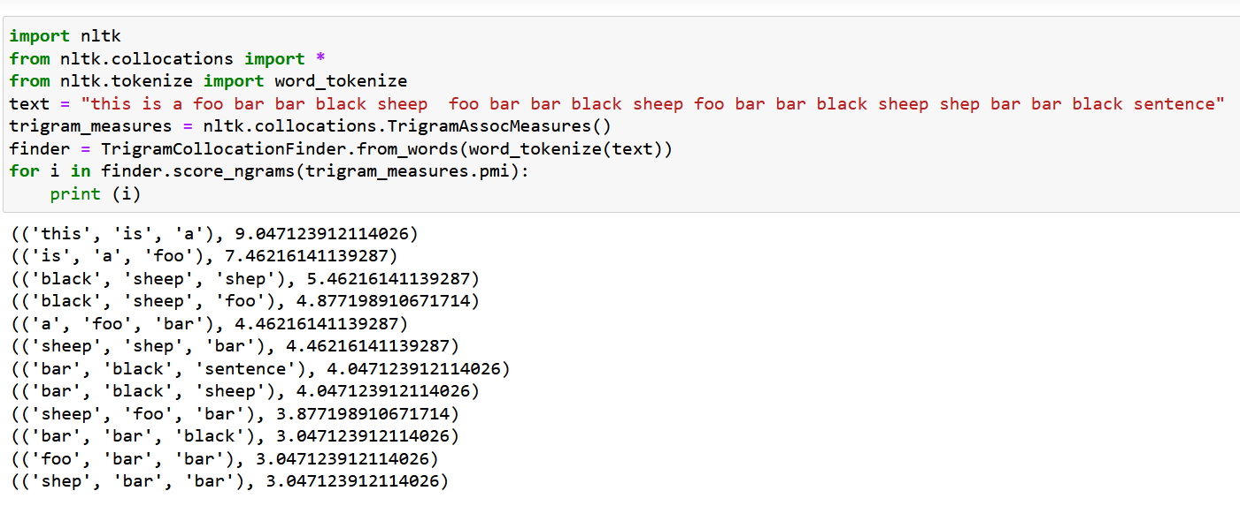
Collocation (Pointwise mutual information or PMI)
Example :

Slide 25
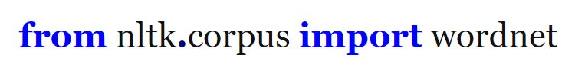
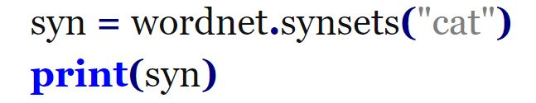
Synonym and antonym
We will use wordnet, which is an NLTK corpus reader, an English lexical database to find synonyms and antonyms.
It can be defined as a semantically oriented English dictionary.
If a word is not defined in wordnet, it might not be identified as a synonym or antonym.
We use synsets() on wordnet to find synonyms for a word.

Slide 26
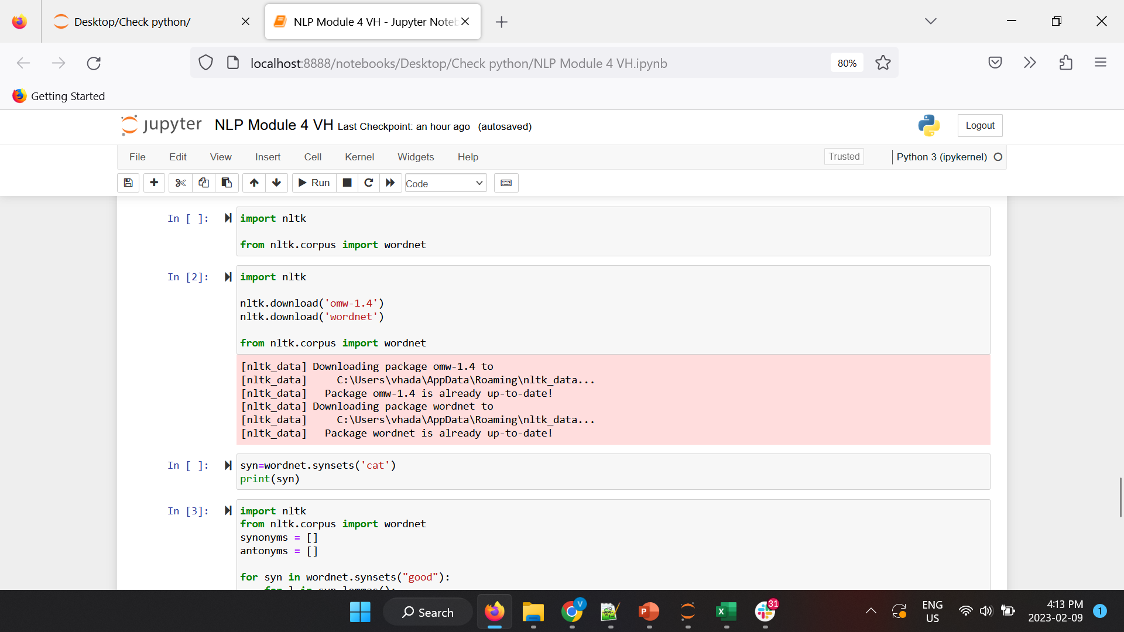
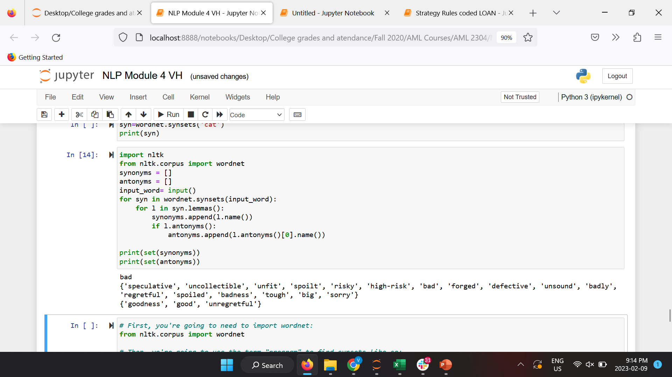
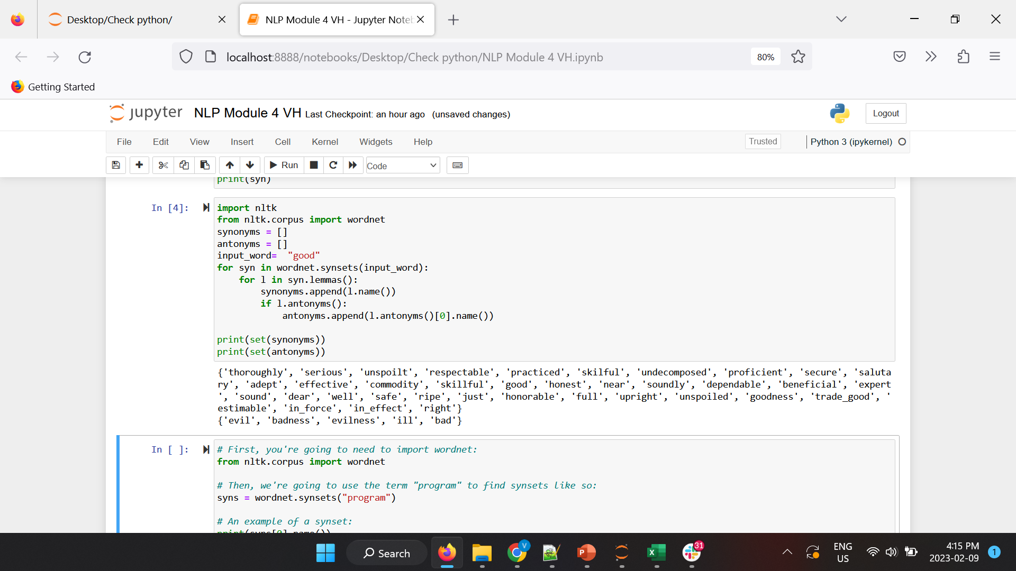
Synonym and antonym

Slide 27
Wordnet
WordNet is a large lexical database of English. Nouns, verbs, adjectives and adverbs are grouped into sets of cognitive synonyms (synsets), each expressing a distinct concept. Synsets are interlinked by means of conceptual-semantic and lexical relations.
WordNet’s structure makes it a useful tool for computational linguistics and natural language processing.
WordNet superficially resembles a thesaurus, in that it groups words together based on their meanings. However, there are some important distinctions.
First, WordNet interlinks not just word forms—strings of letters—but specific senses of words. As a result, words that are found in close proximity to one another in the network are semantically disambiguated.
Second, WordNet labels the semantic relations among words, whereas the groupings of words in a thesaurus does not follow any explicit pattern other than meaning similarity.

Slide 28
Wordnet (Synsets)
Synsets are used to store synonyms, where each word in the Synset shares the same meaning.
Essentially, each Synset is a collection of synonyms. Some words have just one Synset, while others have multiple Synsets.
Every Synset has a definition associated with it. Synset makes it easier for users to look up words in the WordNet database.
Synset components:
<lemma> is the word’s morphological stem
<pos> is one of the module attributes ADJ, ADJ_SAT, ADV, NOUN or VERB
n NOUN
v VERB
a ADJECTIVE
s ADJECTIVE SATELLITE
r ADVERB
<number> is the sense number, counting from 0. This is used to disambiguate word meanings.

Slide 29
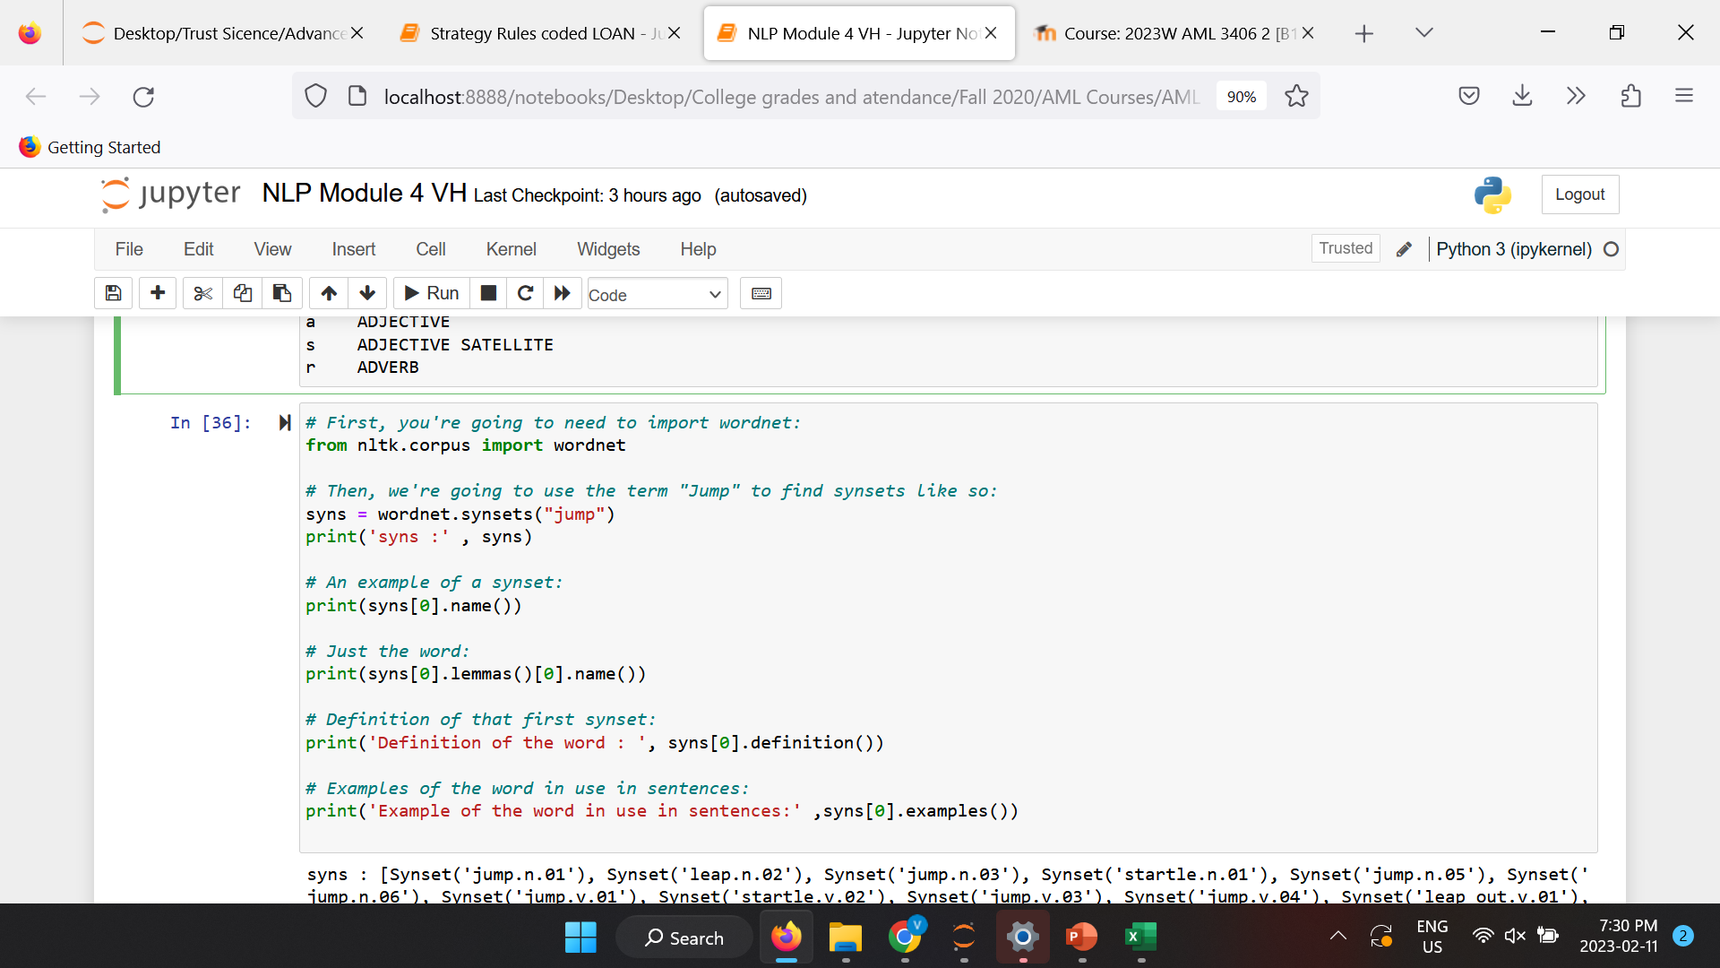
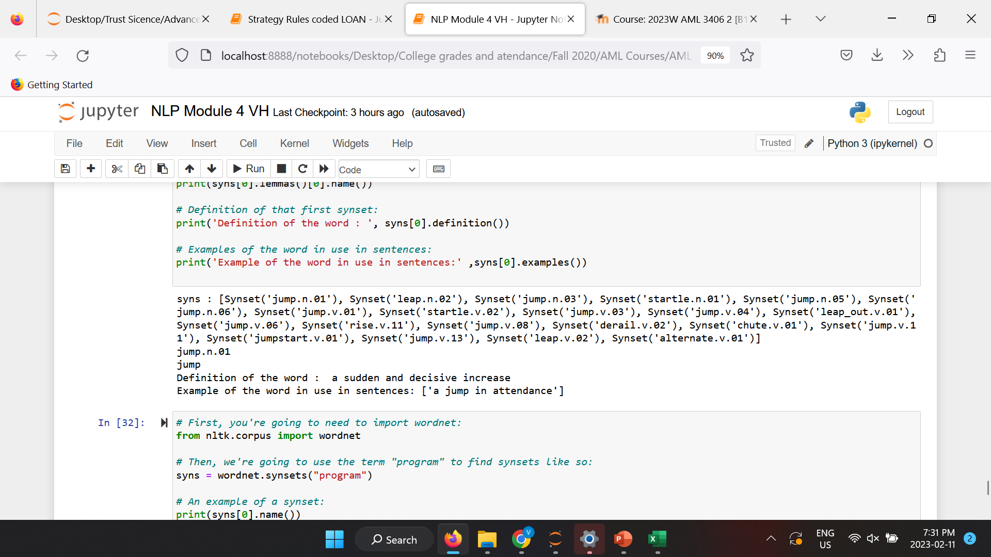
Wordnet
Example :

Slide 30
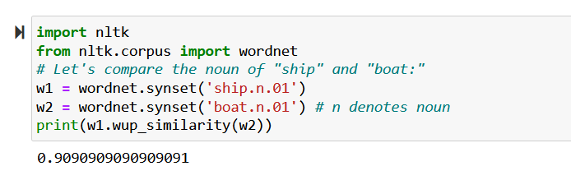
Similarity between words
Now , let’s compare the similarity index of any two words

Slide 31
4.6 Demonstrate use of Word Lengthening to detect sentiment

Slide 32
Fixing word lengthening Intro to re. compile()
Let’s first practice re.compile as this is needed for word lengthening correction:
Python’s re.compile() method is used to compile a regular expression pattern provided as a string into a regex pattern object (re.pattern).
Later we can use this pattern object to search for a match inside different target strings using regex methods such as a re.match() or re.search().
In simple terms, We can compile a regular expression into a regex object to look for occurrences of the same pattern inside various target strings without rewriting it.
re.compile(pattern, flags=0)
pattern: regex pattern in string format, which you are trying to match inside the target string.
flags: The expression’s behavior can be modified by specifying regex flag values. This is an optional parameter

Slide 33
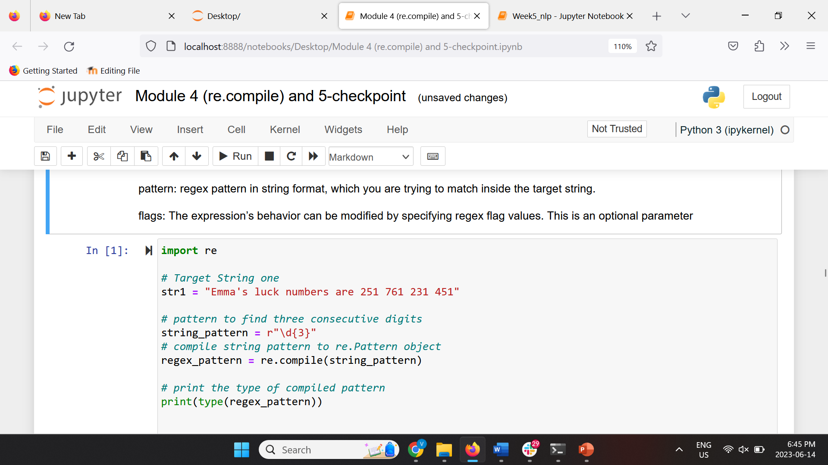
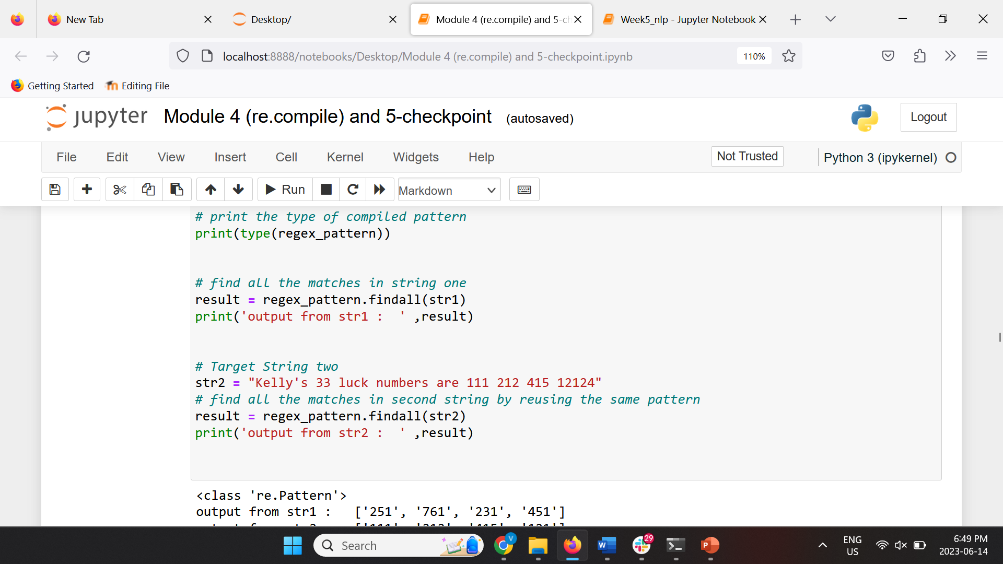
re.compile()

Slide 34
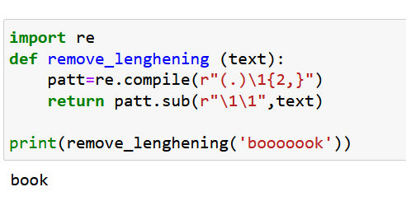
Fixing word lengthening
Word lengthening refers to the process of repeating characters.
In English, words can only have a maximum of two characters repeated.
Any additional characters should be done away with; otherwise, we may be dealing with misleading information.
We can use the regular expressions' library to help us remove any repeated characters from our text .
The code below is not perfect, try developing a better logics!

Slide 35
4.7 Apply Spell Correction

Slide 36
Spell checker
This is the process by which the spelling of a word is corrected.
Spell correction algorithms work based on min-edit functions since brute forcing one's may take too much time.
For the mid-edit functions to work effectively, word lengthening should be used first.
NLTK comes with no spell correction module, but there are numerous other libraries that we can use to perform this task.

Slide 37
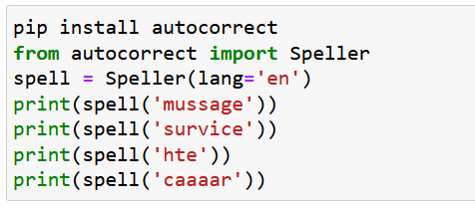
Spell checker (autocorrect)
Spell check with autocorrect

Slide 38
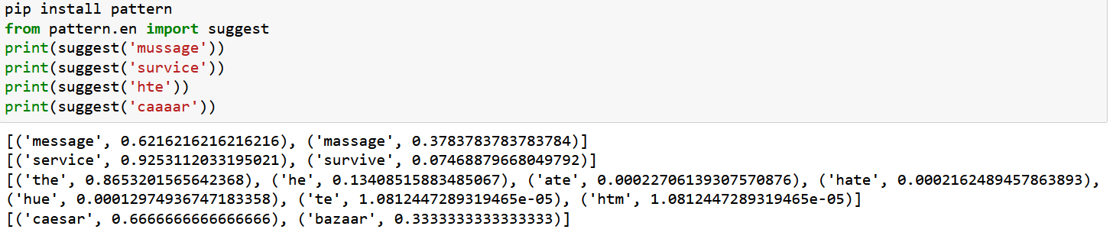
Spell checker (pattern.en )
Spell check with pattern.en

Slide 39
Any questions so far? Any comments?

